Slide 1
Chapter 26
IPv6 Addressing

Slide 2
INTRODUCTION
An IPv6 address is 128 bits or 16 bytes (octet) long as shown in Figure. The address length in IPv6 is four times of the length address in IPv4.

Slide 3
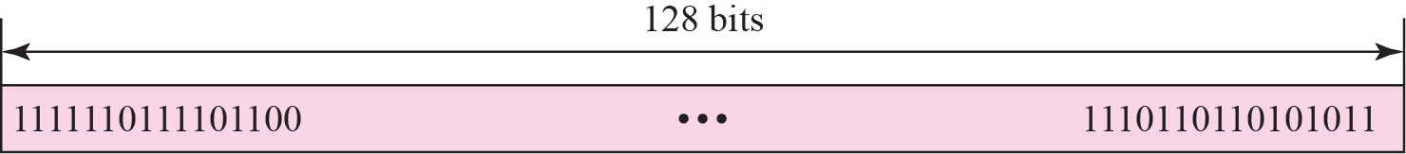
Figure 26.1 IPv6 addresses
Binary Notation :

Slide 4
Figure 26.2 Colon hexadecimal notation
Colon Hexadecimal Notation :

Slide 5
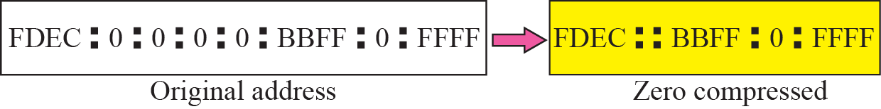
Figure 26.3 Zero compression

Slide 6
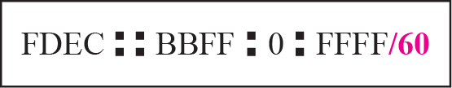
Figure 26.4 CIDR address

Slide 7
Example 26.1
Show the unabbreviated colon hex notation for the following IPv6 addresses:
a. An address with 64 0s followed by 64 1s.
b. An address with 128 0s.
c. An address with 128 1s.
d. An address with 128 alternative 1s and 0s.
Solution
a. 0000:0000:0000:0000:FFFF:FFFF:FFFF:FFFF
b. 0000:0000:0000:0000:0000:0000:0000:0000
c. FFFF:FFFF:FFFF:FFFF:FFFF:FFFF:FFFF:FFFF
d. AAAA:AAAA:AAAA:AAAA:AAAA:AAAA:AAAA:AAAA

Slide 8
Example 26.2
The following shows the zero contraction version of addresses in Example 26.1 (part c and d cannot be abbreviated)
a. :: FFFF:FFFF:FFFF:FFFF
b. ::
c. FFFF:FFFF:FFFF:FFFF:FFFF:FFFF:FFFF:FFFF
d. AAAA:AAAA:AAAA:AAAA:AAAA:AAAA:AAAA:AAAA

Slide 9
Example 26.3
Show abbreviations for the following addresses:
a. 0000:0000:FFFF:0000:0000:0000:0000:0000
b. 1234:2346:0000:0000:0000:0000:0000:1111
c. 0000:0001:0000:0000:0000:0000:1200:1000
d. 0000:0000:0000:0000:0000:FFFF:24.123.12.6
Solution
a. 0:0:FFFF::
b. 1234:2346::1111
c. 0:1::1200:1000
d. ::FFFF:24.123.12.6

Slide 10
Example 26.4
Decompress the following addresses and show the complete unabbreviated IPv6 address:
a. 1111::2222
b. ::
c. 0:1::
d. AAAA:A:AA::1234
Solution
a. 1111:0000:0000:0000:0000:0000:0000:2222
b. 0000:0000:0000:0000:0000:0000:0000:0000
c. 0000:0001:0000:0000:0000:0000:0000:0000
d. AAAA:000A:00AA:0000:0000:0000:0000:1234

Slide 11
26-2 ADDRESS SPACE ALLOCATION
Like the address space of IPv4, the address space of IPv6 is divided into several blocks of varying size and each block is allocated for special purpose. Most of the blocks are still unassigned and have been left aside for future use. To better understand the allocation and the location of each block in address space, we first divide the whole address space into eight equal ranges. This division does not show the block allocation, but we believe it shows where each actual block is located (Figure 26.5).

Slide 12
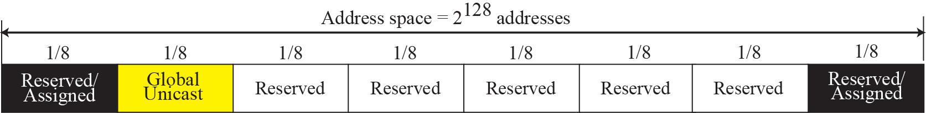
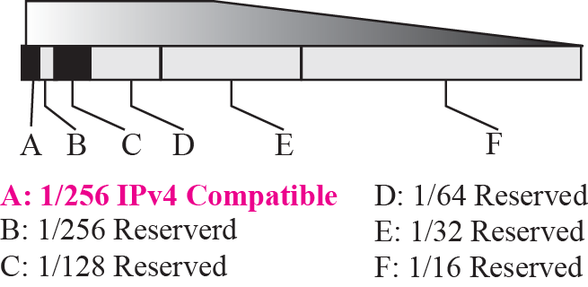
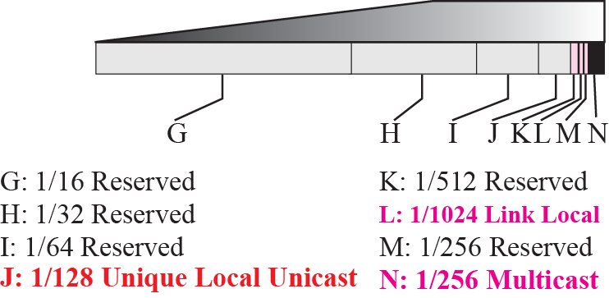
Figure 26.5 Address space allocation

Slide 14
Example 26.8
Figure 26.5 shows that only a portion of the address space can be used for global unicast communication. How many addresses are in this block?
Solution
This block occupies only one-eighth of the address spaces. To find the number of addresses, we can divide the total address space by 8 or 2³ . The result is (2¹²⁸)/(2³) = 2¹²⁵ —a huge block.

Slide 15
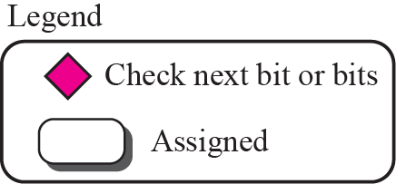

Figure 26.6 Algorithm for finding the allocated blocks

Slide 16
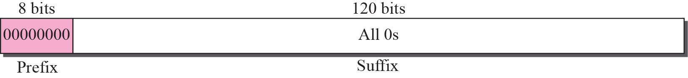
Figure 26.7 Unspecified address

Slide 17

Note
The unspecified address in IPv6 is ::/128. It should never be used as a destination address.

Slide 18
Example 26.9
Comparing the unspecified address in IPv4 to the unspecified addresses in IPv6.
Solution
In both architectures, an unspecified address is an all-zero address. In IPv4 this address is part of class A address; in IPv6 this address is part of the reserved block.

Slide 19
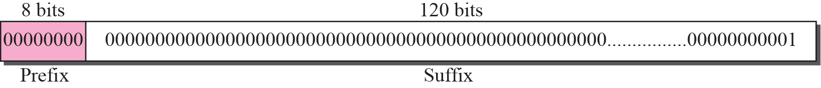
Figure 26.8 Loopback address

Slide 20
Note
The loopback address in IPv6 is ::1/128.
It should never be used as a destination address.

Slide 21
Example 26.10
Compare the loop addresses in IPv4 to the loopback address in IPv6.
Solution
There are two differences in this case. In classful addressing, a whole block is allocated for loopback addresses; in IPv6 only one address is allocated as the loopback address. In addition, the loopback block in classful addressing is part of the class A block. In IPv6, it is only one single address in the reserved block.

Slide 22
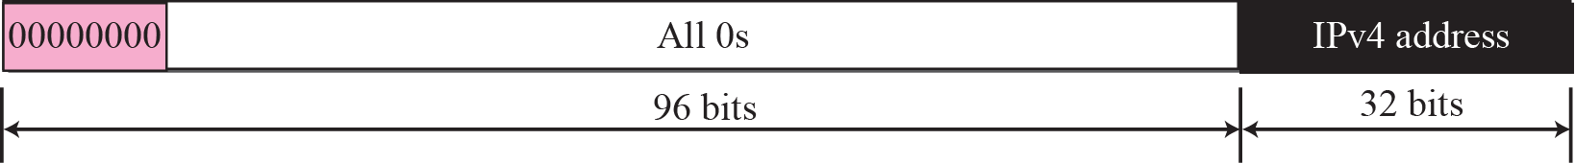
Embedded IPv4 Addresses :
During the transition from IPv4 to IPv6, hosts can use their IPv4 addresses embedded in IPv6 addresses
Figure 26.9 Compatible address
Used when a computer using IPv4 wants to send a message to another computer using IPv6.
For example, the IPv4 address 2.13.17.14 (in dotted decimal format) becomes 0::2.13.17.14 (in mixed format).

Slide 23
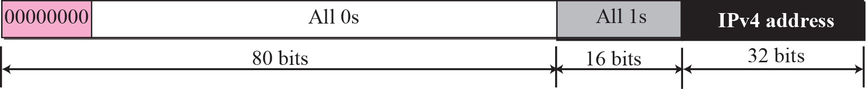
Figure 26.10 Mapped address
Used when a computer that has migrated to IPv6 wants to send a packet to a computer still using IPv4
For example, the IPv4 address 2.13.17.14 (in dotted decimal format) becomes 0::FFFF:2.13.17.14 (in hexadecimal colon format).

Slide 24
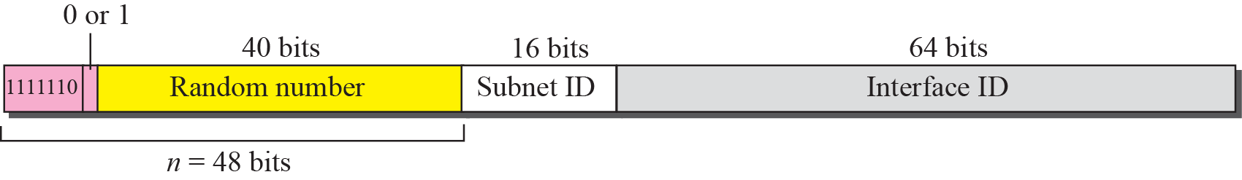
IPv6 uses two large blocks for private addressing: one at the site level and one at the link level.
Unique Local Unicast
Link Local Unicast
Figure 26.11 Unique local unicast address
FC00::/7
a unique local unicast block can be privately created and used by a site.
not expected to be routed

Slide 25
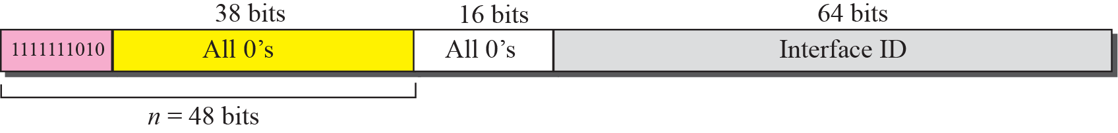
Figure 26.12 Link local address
FE80::/10

Slide 26
Figure 26.13 Multicast address
A permanent group address is defined by the Internet authorities and can be accessed at all times.
A transient group address, on the other hand, is used only temporarily.
The third field defines the scope of the group address.

Slide 27
26-3 GLOBAL UNICAST ADDRESSES
This block in the address space that is used for unicast (one-to-one) communication between two hosts in the Internet is called global unicast address block. CIDR notation for the block is 2000::/3, which means that the three leftmost bits are the same for all addresses in this block (001). The size of this block is 2¹²⁵ bits, which is more than enough for the Internet expansion in the many years to come.

Slide 28
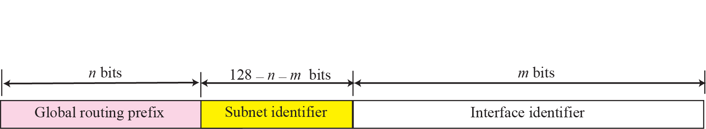
Figure 26.14 Global unicast address

Slide 30
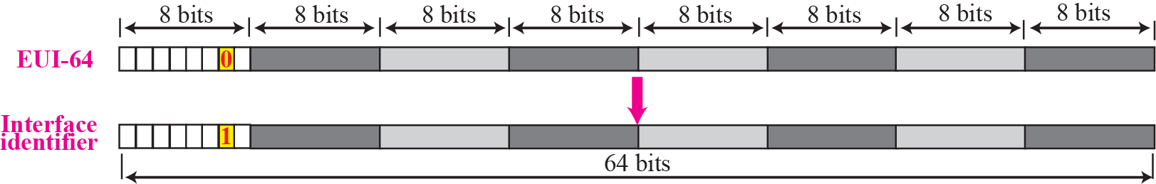
Figure 26.15 Mapping for EUI-64

Slide 31
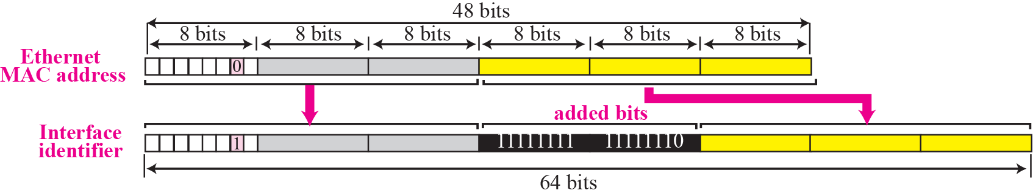
Figure 26.16 Mapping for Ethernet MAC

Slide 32
Example 26.11
Find the interface identifier if the physical address in the EUI is (F5-A9-23-EF-07-14-7A-D2)₁₆ using the format we defined for Ethernet addresses.
Solution
We only need to change the seventh bit of the first octet from 0 to 1 and change the format to colon hex notation. The result is F7A9:23EF:0714:7AD2.

Slide 33
Example 26.12
Find the interface identifier if the Ethernet physical address is (F5-A9-23-14-7A-D2)₁₆ using the format we defined for Ethernet addresses.
Solution
We only need to change the seventh bit of the first octet from 0 to 1, insert two octet FFFE16 and change the format to colon hex notation. The result is F7A9:23FF:FE14:7AD2 in colon hex.

Slide 34
Example 26.13
An organization is assigned the block 2000:1456:2474/48. What is the CIDR notation for the blocks in the first and second subnets in this organization.
Solution
Theoretically, the first and second subnets should use the block with subnet identifier 0001₁₆ and 0002₁₆. This means that the blocks are
2000:1456:2474:0000/64
and
2000:1456:2474:0001/64.

Slide 35
Example 26.14
An organization is assigned the block 2000:1456:2474/48. What is the IPv6 address of an interface in the third subnet if the IEEE physical address of the computer is (F5-A9-23-14-7A-D2)₁₆.
Solution
The interface identifier is F7A9:23FF:FE14:7AD2 (see Example 26.12). If we add this identifier to the global prefix and the subnet identifier, we get:

Slide 36
26-4 AUTOCONFIGURATION
One of the interesting features of IPv6 addressing is the autoconfiguration of hosts. As we discussed in IPv4, the host and routers are originally configured manually by the network manager. However, the Dynamic Host Configuration Protocol, DHCP, can be used to allocate an IPv4 address to a host that joins the network. In IPv6, DHCP protocol can still be used to allocate an IPv6 address to a host, but a host can also configure itself.

Slide 37

Example 26.15
Assume a host with Ethernet address (F5-A9-23-11-9B-E2)₁₆ has joined the network. What would be its global unicast address if the global unicast prefix of the organization is 3A21:1216:2165 and the subnet identifier is A245:1232.
Solution
The host first creates its interface identifier as
F7A9:23FF:FE11:9BE2
using the Ethernet address read from its card. The host then creates its link-local address as

Slide 38

Example 26.15 Continued
Assuming that this address is unique, the host sends a router solicitation message and receives the router advertisement message that announces the combination of global unicast prefix and the subnet identifier as 3A21:1216:2165:A245:1232. The host then appends its interface identifier to this prefix to find and store its global unicast address as:

Slide 39
26-5 RENUMBERING
To allow sites to change the service provider,
Renumbering of the address prefix (n) was built into IPv6 addressing. As we discussed before, each site is given a prefix by the service provider to which it is connected. If the site changes the provider, the address prefix needs to be changed. A router to which the site is connected can advertise a new prefix and let the site use the old prefix for a short time before disabling it. In other words, during the transition period, a site has two prefixes.

Slide 40
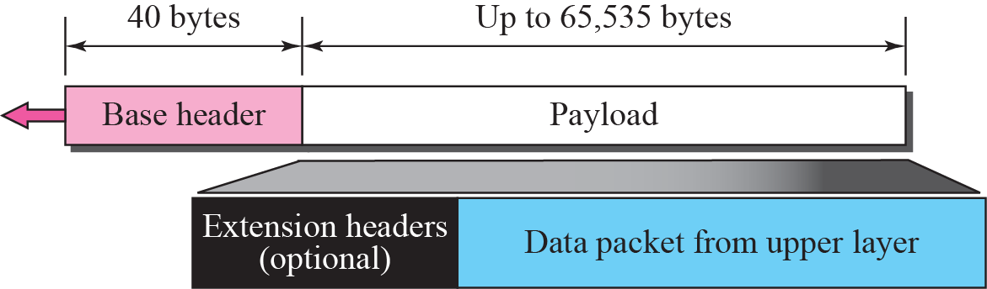
Figure 27.1 IPv6 datagram

Slide 41
27-3 TRANSITION FROM IPv4 TO IPv6
Because of the huge number of systems on the Internet, the transition from IPv4 to IPv6 cannot happen suddenly. It will take a considerable amount of time before every system in the Internet can move from IPv4 to IPv6. The transition must be smooth to prevent any problems between IPv4 and IPv6 systems. Three strategies have been devised by the IETF to help the transition (see Figure 27.16).

Slide 42
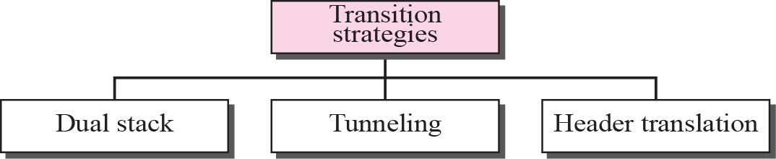
Figure 27.16 Three transition strategies

Slide 43
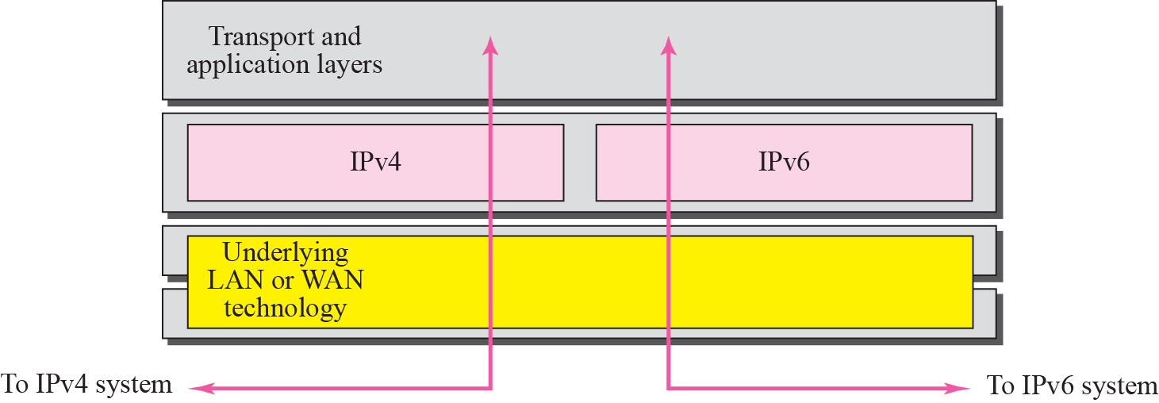
Figure 27.17 Dual stack

Slide 44
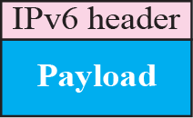
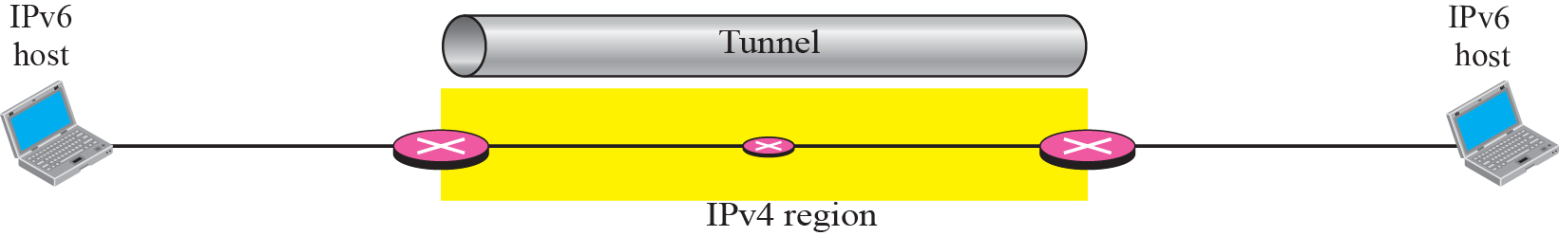
Figure 27.18 Tunneling strategy

Slide 45
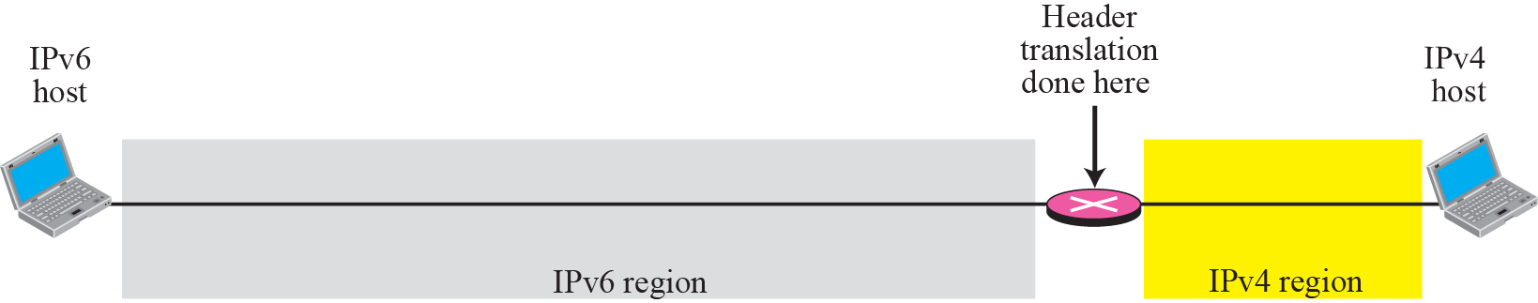
Figure 27.19 Header translation strategy

